Slide 1


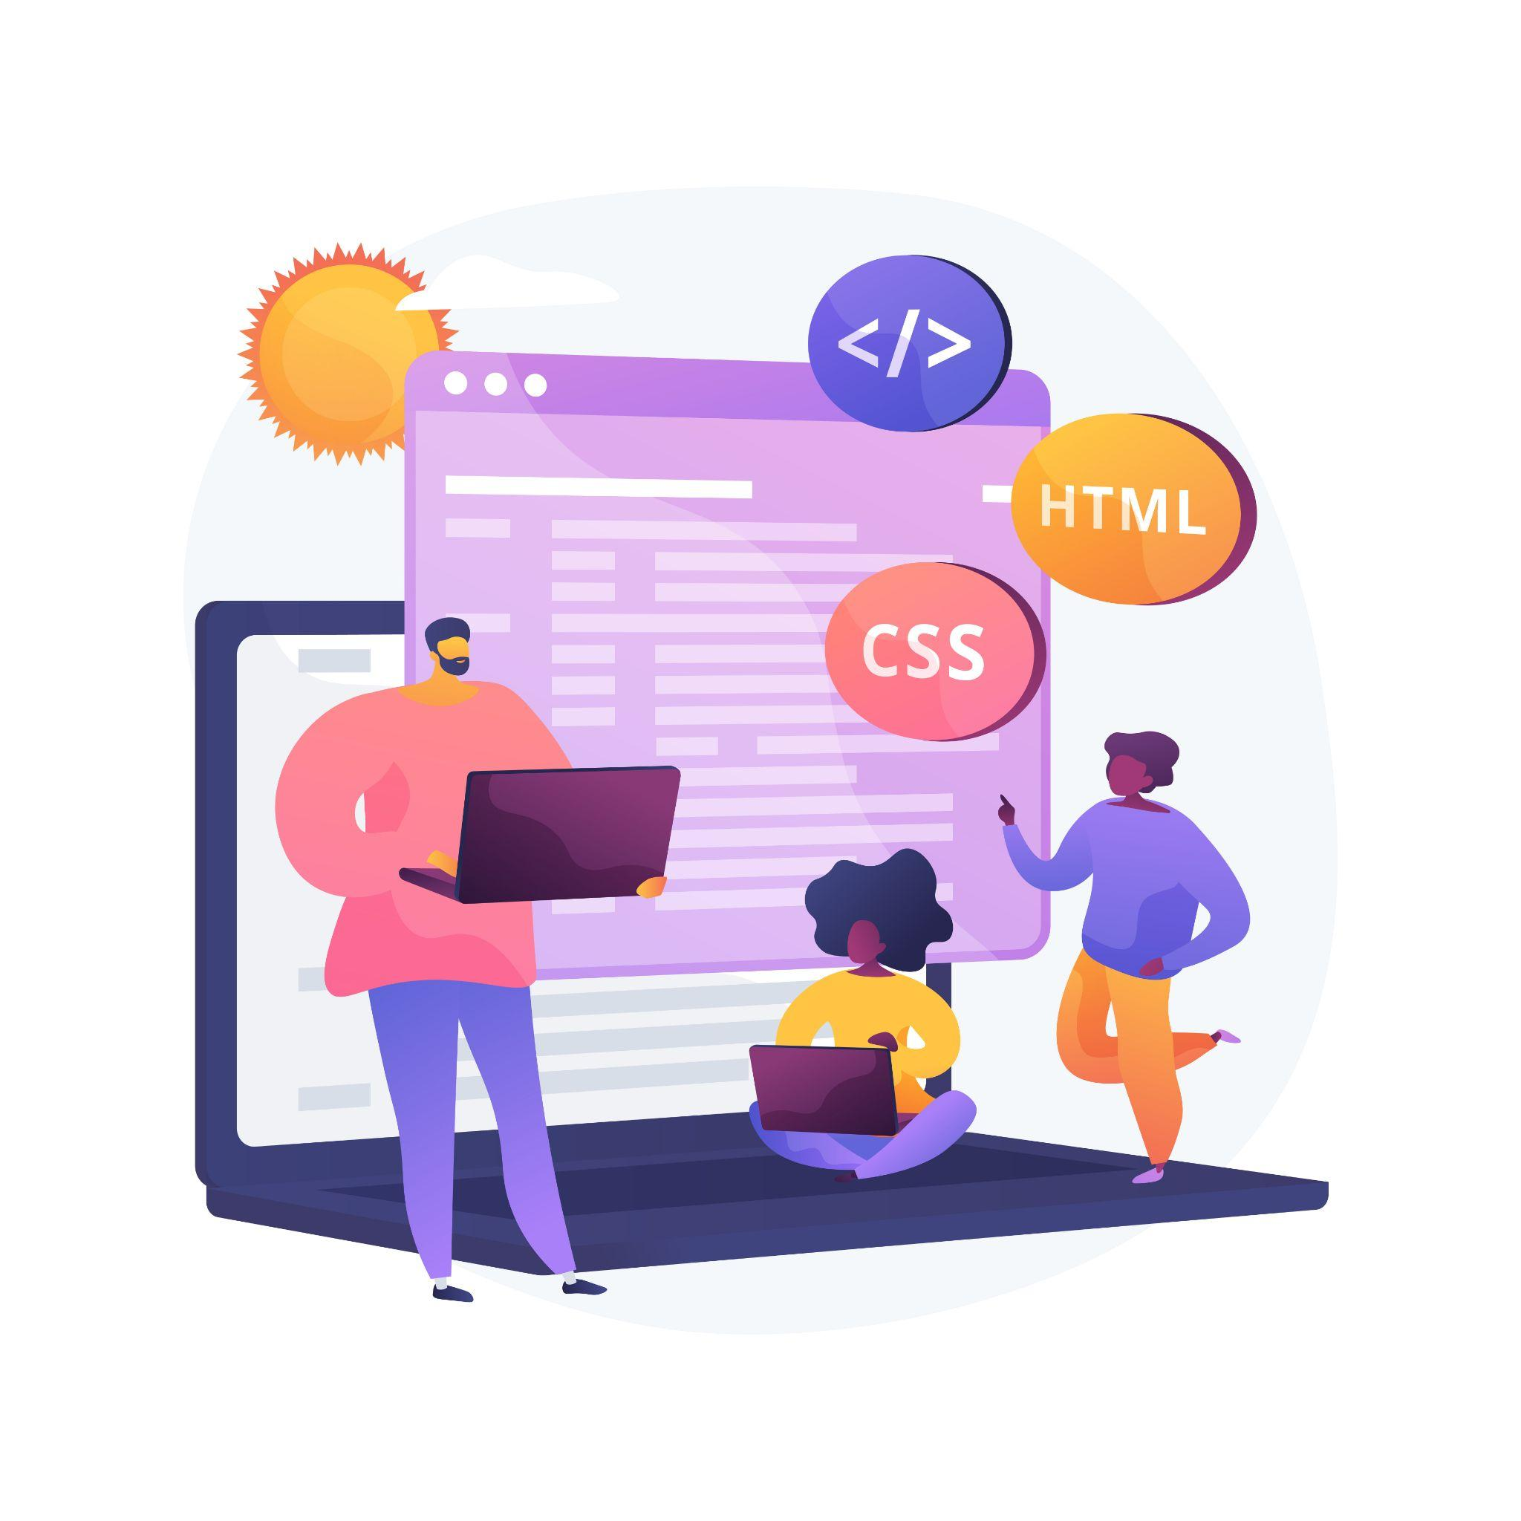



Lecture 7:
Event Propagation
Course - Web Development - II
-By
Instructor Name
welcome@krmangalam.edu.in
Sohna Road,Gurugram,Haryana 122103

Slide 2

| Table of Contents
Bubbling
Capturing
preventDefault()
References.
The End.

Slide 3

|
If you have a button inside a div, and both have a click listener, which one runs first when you click the button?

Slide 4
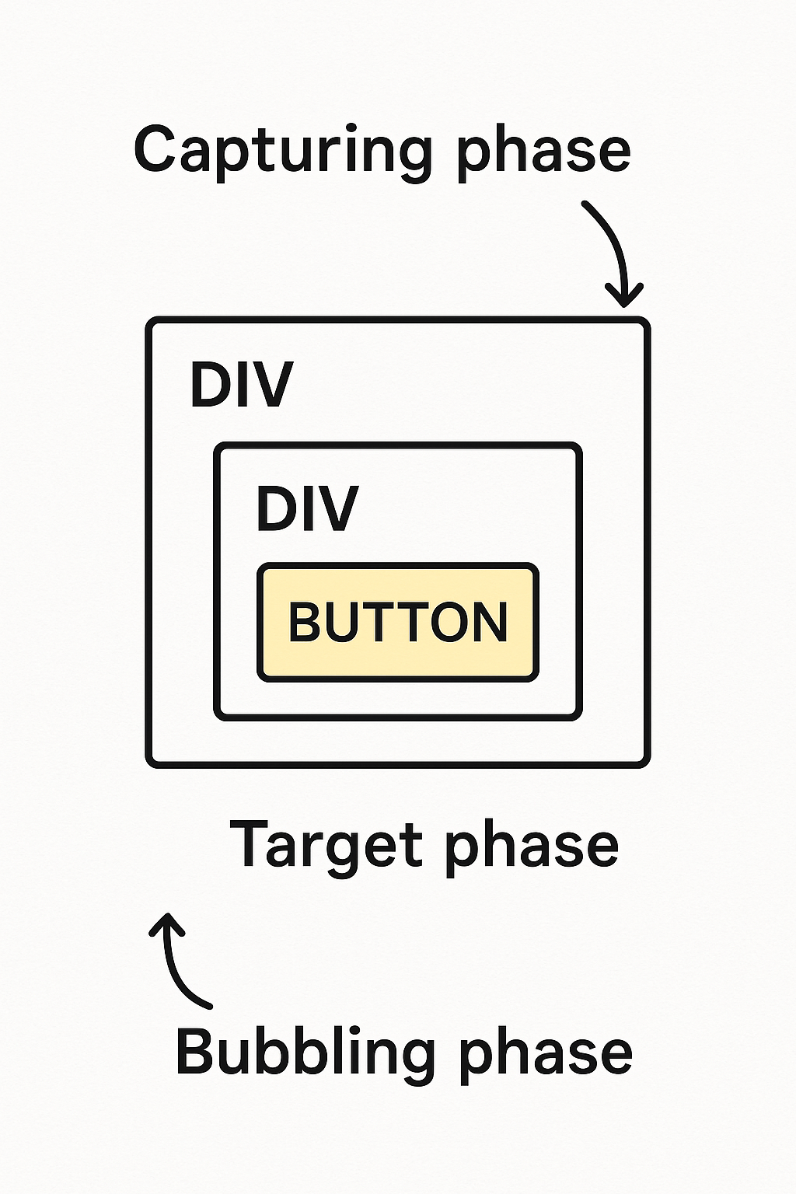
|
If you have a button inside a div, and both have a click listener, which one runs first when you click the button?
The answer is 'it depends,' and it reveals a fundamental mechanism of how events travel through the DOM called Event Propagation."

Slide 5
| Event Propagation
Event Propagation is the process that defines how events travel through the DOM tree when an event is triggered (like a click).
It determines which elements respond first — parent or child — and in what order they respond.
Event Propagation has 3 phases:
Capturing Phase:
Event moves from the root (document) down towards the target element.
Target Phase:
The event reaches the exact element that was interacted with.
Bubbling Phase:
Event then moves back up from the target to the root.

Slide 6
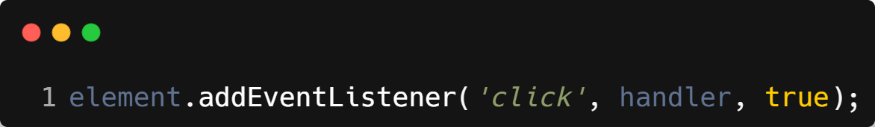
| Event Capturing
Event travels from the outermost parent down to the target element.
Executed first, when useCapture is set to true in addEventListener.
Order: Document → HTML → Body → Parent → Child (Target)
Syntax :

Slide 7
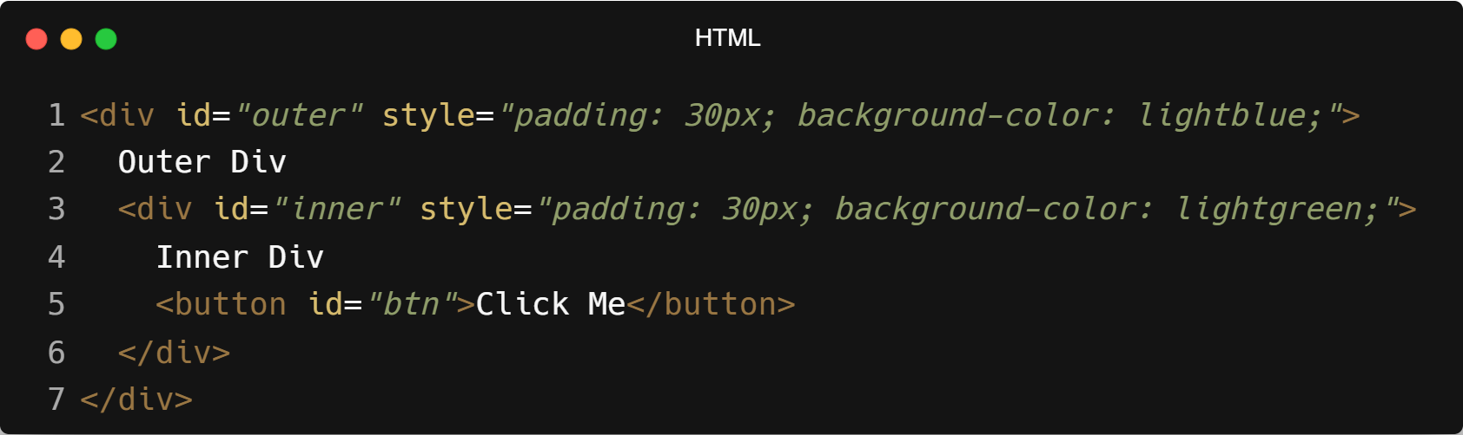
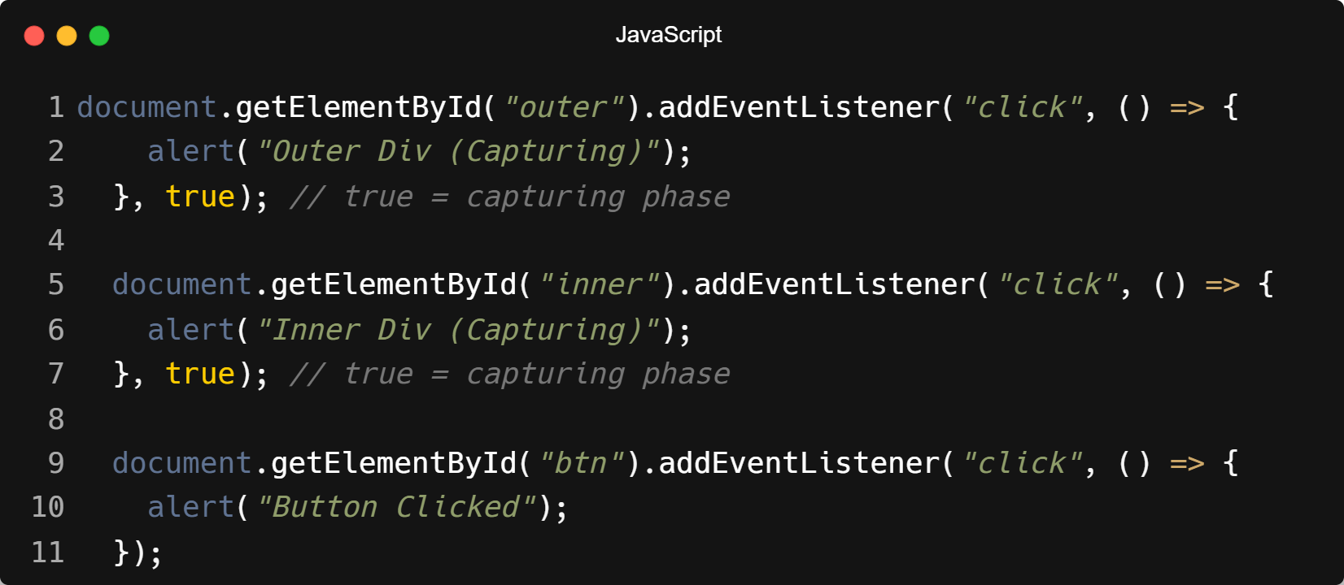
| Example : Event Capturing

Slide 8
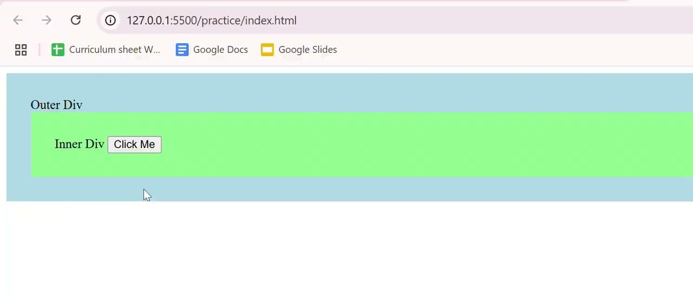
| Output : Event Capturing

Slide 9
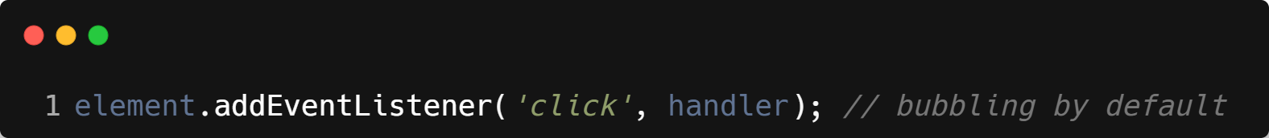
| Event Bubbling
Event starts at the target element and bubbles up to its ancestors.
This is the default behavior in JavaScript.
Order: Target → Parent → Body → HTML → Document
Syntax :

Slide 10
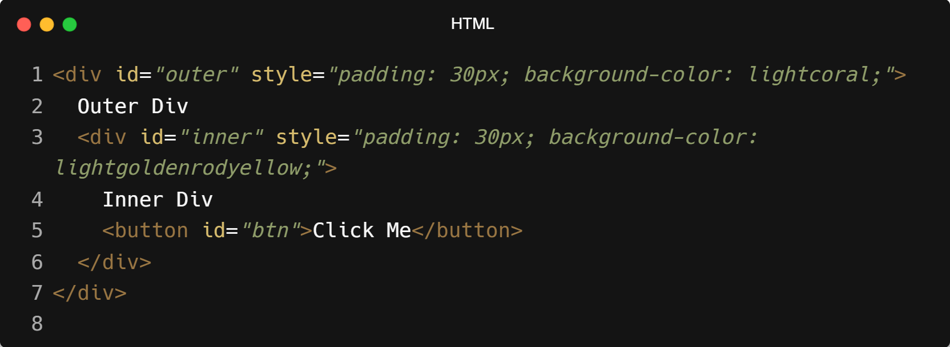
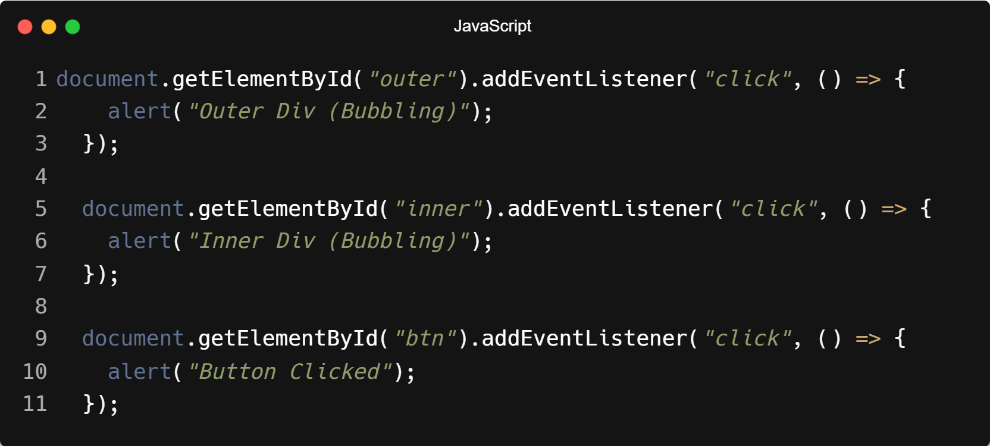
| Example : Event Bubbling

Slide 11
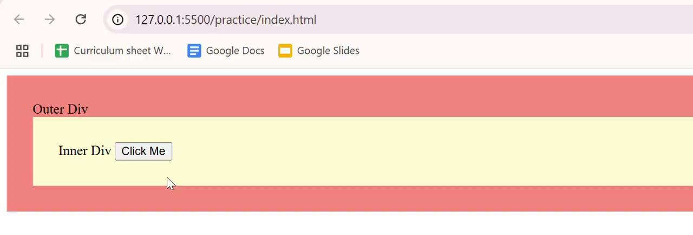
| Output : Event Bubbling

Slide 12
|
Some HTML elements have default behaviors — like <a> navigating or <form> refreshing. But what if we want JavaScript to handle those actions instead?

Slide 13
|
Some HTML elements have default behaviors — like <a> navigating or <form> refreshing. But what if we want JavaScript to handle those actions instead?
We need a way to tell the browser, 'Stop! Don't do your default action. I'll take it from here.'"
exactly what event.preventDefault() does — it stops the browser’s automatic behavior so we can handle things our way using JavaScript.
When an event listener runs, it gets an Event object (e) with details about the event — like which key was pressed or where the mouse was clicked.

Slide 14
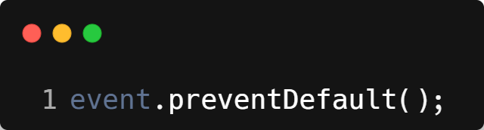
| event.preventDefault()
A method on the event object that stops the browser from executing its default action for that event.
Syntax :

Slide 15
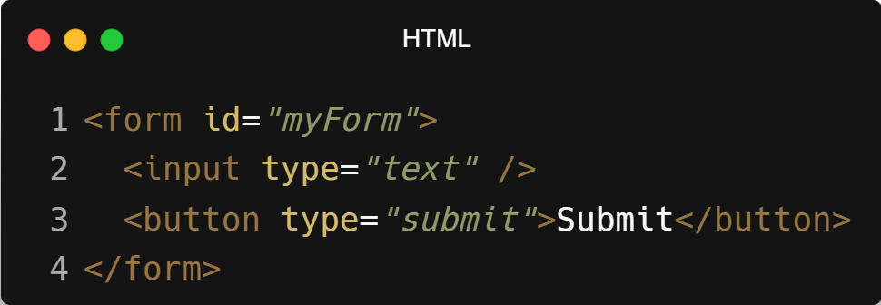
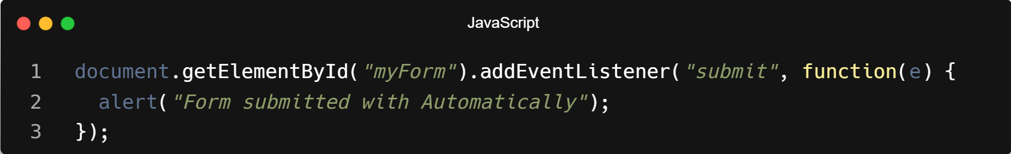
| Example : without event.preventDefault()

Slide 16
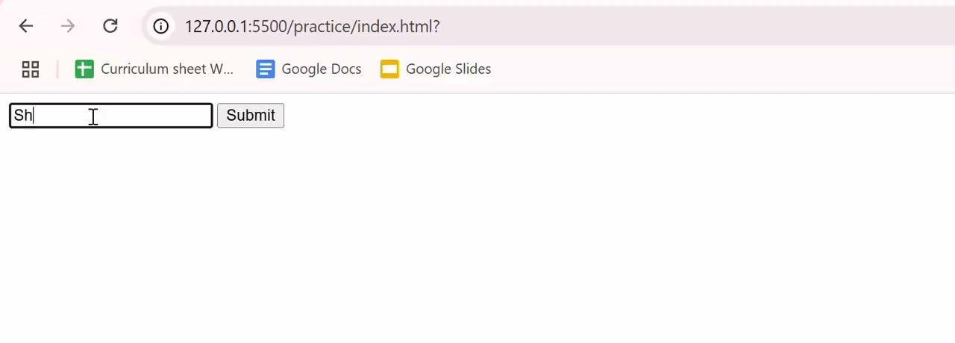
| Output : without event.preventDefault()

Slide 17
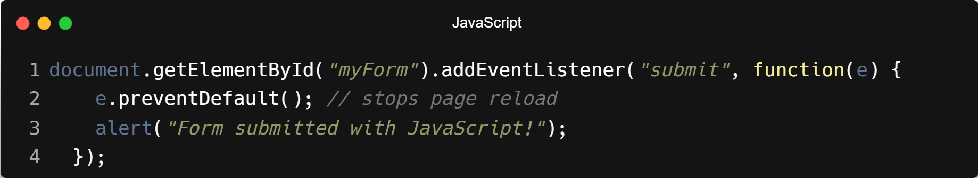
| Example : with event.preventDefault()

Slide 18
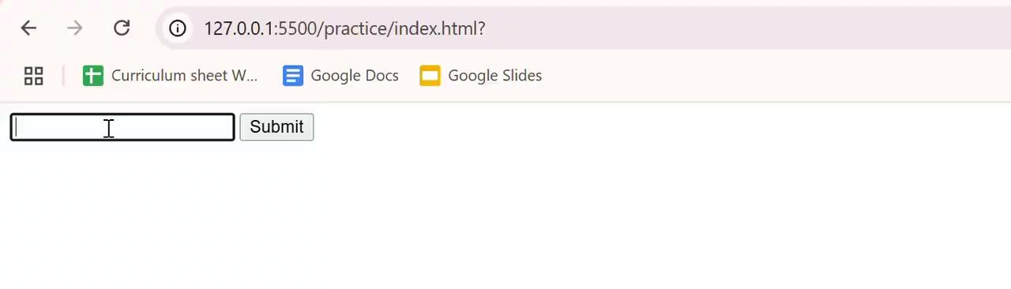
| Output : with event.preventDefault()

Slide 19
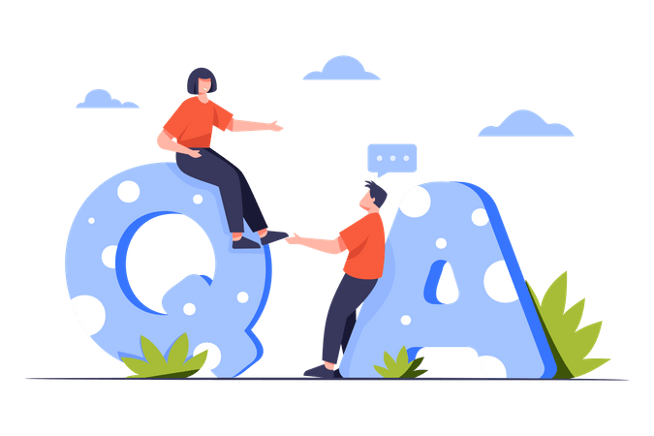
| Check Your Understanding
Question : In modern browsers, what is the default phase of event propagation?
Options : a) Capturing
b) Targeting
c) Bubbling
d) It is random
Answer : c) Bubbling
Explanation:
By default, event listeners respond during the bubbling phase, where the event "bubbles up" from the target element to its ancestors.

Slide 20
| Check Your Understanding
Question : During the event bubbling phase, where does the event "travel"?
Options : a) From the window object down to the target element.
b) From the target element up to its ancestors (parent, grandparent, etc.).
c) Only on the target element; it does not travel.
d) From the target element to its sibling elements.
Answer : b) From the target element up to its ancestors (parent, grandparent, etc.).
Explanation:
Bubbling describes the process where an event, after firing on its target, propagates upwards through the DOM tree to parent elements.

Slide 21
| References
MDN Web Docs : Comprehensive and official documentation for JS.
🔗https://developer.mozilla.org/en-US/docs/Web/JavaScript
W3Schools – JS Tutorial : Beginner-friendly JS tutorials with examples and interactive editors.
🔗 https://www.w3schools.com/js/
JavaScript.info - A comprehensive tutorial-style website that covers core JavaScript concepts in depth.
🔗https://javascript.info/

Slide 22
Thanks
For
Watching
Course - Web Development - II
welcome@krmangalam.edu.in
Sohna Road,Gurugram,Haryana 122103

